Slide 1
Data Context
PrintNet T

Slide 2
Agenda
Introduction
Data | Records by
Pages | Repeated by
Page | Repeated by
Repeated Flows
Repeated Row Sets
System Variables
Possible Problems and Issues

Slide 3

Introduction

Slide 4


Data Context – Example
Travel agency letter job has an input data structure which is somehow complex. It is
necessary to use and display some values from it in Layout properly.
Open TravelAgency.wfd
Run data proof and look at the data structure
There are three major arrays (Clients, Params, TripTypes)
Clients array has one sub-array TripID
TripID array has two sub-arrays and one of them has one more sub-array
It is not possible to use just simple flows to display the values from different levels
Therefore Repeated By functionality must be used in Layout
Notes:
This repeated functionality deals with Records By, Pages Repeated by, Repeated Flows

Slide 5
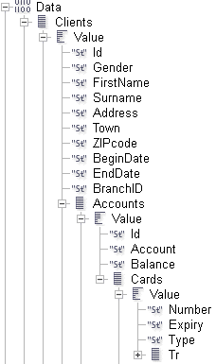

Data Context Schema
Data context:
Telling PrintNet T where to look
in order to:
  Display variables
  Use variables
Specifies only the selected level
(any sub-levels must be managed
separately)
Notes:
Display variables – drag and drop into a flow area
Use – in chart, images, etc.
Sub-levels = sub-arrays

Slide 6
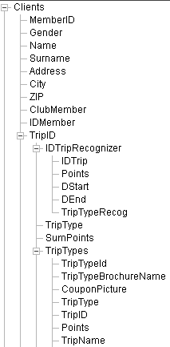

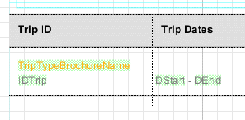
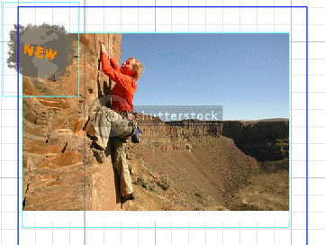

Data Context – Example
Data Proof
Layout
Notes:
On this slide you can see that variables from different levels or sub-arrays are placed in layout into different objects (Flows, row sets, images).
These objects have different functionality, i.e. some of them are not necessarily simple.
Repeated by functionality will have to be applied for displaying or using variables from sub-arrays.
The reason why it is not easy to just drag and drop a variable from any array and use it is that these arrays are nested and dragging and dropping a variable out of them will cause a very known error: Data used in context where it does not exist.

Slide 7
Context Specification
Context can be managed via:
Data | Records by
Pages | Repeated by
Page | Repeated by
Flow | Repeated
Row Set | Repeated

Slide 8

2. Data | Records by

Slide 9

Data | Records by – Purpose
Specification of data repetition needed
One document design printed for each set of values
Need of splitting each record into a single file
Notes:
Defines the repetition of the data and, therefore, the whole layout design
The layout design is repeated for each set of data that is read into Layout (Clients, Company, Empty). Selecting a variable (array) in this combo-box defines how the data will be repeated when the workflow is processed. Therefore, the variable selected also determines the repetition of the design, i.e. there will be one document design printed for each set of values returned by that variable.
By default, if the workflow is reading from either single or merged data files, then the Records variable is automatically selected here. This will result in the amount of repetitions being equal to the amount of records in the data file. This is because Records is a variable of array data-type and controls all of the records that are read into the Layout module, i.e. it counts the records as they are read and recognizes when each new record starts. Therefore, it can repeat the design of the Layout each time that a new record is read.

Slide 10
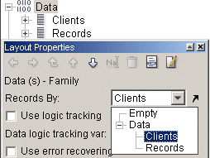
Data | Records by Overview
When designing a document,
you might need to specify
Data | Records By
Layout design is repeated for
each set of data specified in
Records By combo box
Any major array or nothing
can be selected

Slide 11



Data | Records by Schema
Data | Records by Clients
More sets of pages
Data | Records by Empty
1 set of pages
Notes:
Each client has 4 pages generated
In this schema there are two branches:
The first, Records by Clients serves when there is one design and we need to repeat this design by number of all records in Clients array. Example: Account statement (each client receives his/her statement in an envelope) for each client in one file
The second branch serves when there is one design for all clients. We do not intend to create a separate file for each client. Example: Account statements of all clients in one big file. Note: It will still be possible to group sheets using Sheet regrouper and then print a PDF file for each client. Note that this setting is not enough to display the data. Will be explained in the next chapter.

Slide 12

Data | Records by – Tutorial
Design the first part of Bank design.
Open Bank_1.wfd
Double click on Layout module
Create a Flow area and insert there client’s information (Names, Address, Town, ZIP)
Proof the design (causes error)
Check the setting of Data | Records by and select Clients
Proof the design again
Solution at Bank_1_Done.wfd
Notes:
Important note: You will be building a design throughout the whole presentation. You can save your solutions, but you do not have to, because you will be provided with WFD files at the beginning of each new tutorial.

Slide 13
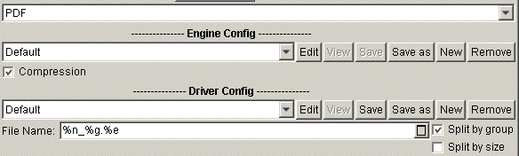
Data | Records by Utilization
Data | Records by option also serves for printing separated groups
Check Split by group option
Do not forget to put a %g variable to the File Name
Production
Notes:
Note: Set of pages might be one file produced via production, more sets of pages might be several files, each file for one set of pages (see previous slides).
In this case PrintNet T will create the same number of PDF files as is the number of records. %g option can be anywhere in the File name, it will make it variable and will increment every file name by 1. If the file name is static, PrintNet T will generate a PDF file with this static name which will be overwritten, so only the last record file will be available.
Note: %g is not the only option how to make variable names of files split by group.

Slide 14
Data | Records by – Tutorial
Each client will have his/her generated PDF file. Print PDF files using Split by group
option in production.
Open Bank_1_Done.wfd
Go into production, check Split by group option and run production
Check the file on your disc, it is only the last record (client)
Return to production and edit the file name, e.g. %n%g_%e
Run the production
Check that each of 12 generated PDF files contains different record/client information
Notes:
The reason why we select Clients’ array and not otherwise is that we intend for each client to have his/her account statement which will be printed into a unique PDF file. If we select empty, there will be no records, so only one single file will be printed (unless Sheet Regrouper is used)
This is not the solution for context error, it can be handled differently, but in this case we need to keep records.
Each customer will have his/her generated PDF file

Slide 15
Data | Records by Comparison
Records by Clients | Records by Empty
Design in Layout is repeated by the number of records in Clients array Possible to split all sheets into corresponding groups (generate a file for each group) File Name of generated files is variable (%g) | Design in Layout is not repeated (unless another repeated by option is specified) Not possible to split sheets into corresponding groups (unless Sheet Regrouper is used) File Name of a generated file can be static
Notes:
Another repeated by option will be discussed later
Note: %g is not the only option how to make variable names of files split by group.

Slide 16

3. Pages | Repeated by

Slide 17
Pages | Repeated by – Purpose
One document design printed for each set of values
Repetition not just by array, also by integer variable
Does not create or manage records (splitting by group creates only one file)
Notes:
Determines which variable will be used to repeat the sequence of pages.
Select an array or an integer variable from the combo-box menu. Every time a new value is returned by that variable, the page sequence will start again.
Of course you can repeat by a variable, but this variable needs to be in a correct context, i.e. Data | Records by | Numbers and then select Pages | Repeated by | Number.

Slide 18
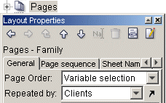
Pages | Repeated by Overview
Page Order must be Variable selected
Selecting by which array (or variable) the pages will be repeated
Sequence restarts with new variable value
Notes:
Determines which variable will be used to repeat the sequence of pages.
Select an array or an integer variable from the combo-box menu. Every time a new value is returned by that variable, the page sequence will start again.
Of course you can repeat by a variable, but this variable needs to be in a correct context, i.e. Data | Records by | Numbers and then select Pages | Repeated by | Number. The variable can be calculated, not only static. If it is calculated, it can be changing during processing, therefore the number of repetitions can change. The variable is applied after each iteration.

Slide 19
Pages | Repeated by Schema
Data | Records by Clients
Combination
Pages | Repeated by Clients
Notes:
In this slide each client has 4 pages
In this schema there are three branches:
The first, Records by Clients (Page order is Simple, not variable selected): we can produce the same number of files as the number of records
The second will create 3 x 3 sequence of pages, i.e. each client (PDF file) will have all clients pages in his/her group. If we print a PDF file for each client, there will be the same number of files as the number of clients (Data | Records by | Clients), but each PDF file will have all clients’ information inside. Each client receives all clients’ information.
The third, Repeated by Clients (Data | Records by Empty): we can produce one single file containing the same number of pages (sets of pages) as the number of records.
When proofing designs, the first branch and the third branch look identical. The second somehow as well, but it is being repeated.

Slide 20
Repeated By for Pages – Example
Open provided file. Specify that records are equal to the generated array of numbers. Repeat pages using below defined condition.
Open Applications.wfd
Imported clients create an array, this array needs to be specified as Records array (Data | Records by)
Test whether your proofing works
Specify that pages will be repeated by a variable Family Members, i.e.:
  First record repeats pages twice
  Second record repeats pages four times
  Last record repeats pages six times
Your solution will generate the total of 12 pages
Solution at Applications_Done.wfd
Notes:
Pages repetition is done via Pages | Repeated by | Number (Not Numbers!!!)

Slide 21



Group Begin Check
When group begin needs to checked, the steps to be taken:
Proof the design
Select Window | Show SheetInfo
Check the newly appeared window
First page of each client (record)
Another than first page of each client (record)
Notes:
This is not an obligatory setting. Group begin is an automatic feature. This enhancement serves just for viewing where the group begin is.
First case can be when you have Data | Records by | Clients and supposed that each client will have several pages, only the first page (of each client) has the GroupBegin set to True. Or there can be Data | Records by | Empty and Pages | Repeated by | Clients set instead. In this case only the first page of all pages will have GroupBegin set to true, the rest will have False.
Second case is when one client has multiple pages and you are viewing another page than his/her first one. It works for Data | Records by | Clients, Pages | Repeated by | Clients or both.

Slide 22
Pages | Repeated by – Exercise
Work with provided file. Try all options from previous slide.
Open Bank_2.wfd
Note that you have to have Split by group option checked in production for the following points
After each modification check the proof and Group Begin value as well
Modify the design and print a PDF file with variable name for each client (group)
Check whether you have printed 12 files
Modify the design and print a PDF file with variable name
Check whether you have printed 1 file with all clients’ information inside
Modify the design and print a PDF file with variable name
Check whether you have printed 12 files (each file has all clients’ information)
Notes:
Data | Records by | Clients (Group begin for each client)
Pages | Repeated by | Clients (Group begin set True for the first sheet of proof, the rest of the sheets have False)
Data | Records by | Clients AND Pages | Repeated by | Clients (Each client has first page Group Begin set to True and 11 pages with False)

Slide 23
4. Page | Repeated by

Slide 24
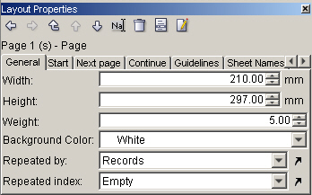
Repeated By for Pages in Layout
Purpose: Complex pages sequence. Each page can be repeated by different array
Notes:
Before, it was necessary to perform scripting in order to specify complex repeated by pages functionality.
Now, it is possible to be implemented by a new feature for pages.

Slide 25
Repeated By for Pages – Example
Using the given data structure, it is possible to specify page logic without any scripting.
This job displays pages for animal orders. Each order has an intro and end page, each member of an order has a separate page.
Open Animals.wfd
Look at the pages logic
  Each order has an introductory page
  Then a series of order members follows
  After the last series member, there is an end page
  The sequence continues with the next order described as above

Slide 26
Page | Repeated by – Tutorial
Work with provided file. Each client will have introduction page, pages with account
information, final page and possibly a filling page.
Open Bank_2.wfd
Define four pages: intro page, account page, final page and possibly a filling page
Define sequence of pages using Repeated by functionality (Intro – Account pages – Final – Filling)
Create a table on the Account page and insert there account related variables
On the Final page write there “Final Page”
On the Filling page write there “Filling Page”
Proof the design and verify in proof that each client has 4 pages, the first page has Group Begin set to True and the rest of his/her pages set to False
Solution at Bank_2_Done.wfd
Notes:
Filling page displays for the client only when his/her number of pages is odd (Select by condition on the Final page – Page counter is odd) – purpose is duplex printing

Slide 27



Repeated By – Exercise
Each client has several accounts. Each account has several transactions.
Transaction 1
Transaction 2
Account 1
Transaction 3
Customer
Transaction 1
Account 2
Transaction 2
Notes:
Pages Repeated By.wfd

Slide 28
Repeated By – Exercise Schema
Create a design where there is an Intro page for each customer, then a special page
with account number followed by a set of pages with one transaction on each of them.
Cover Page
Account 1 Information Page
Transaction 1
Transaction n
Account 2 Information Page
Transaction 1
Transaction n
End Page
Notes:
Pages Repeated By.wfd

Slide 29
Page | Repeated By – Exercise
Create a design where there is an Intro page for each customer, then a special page
with account number followed by a set of pages with one transaction on each of them.
The clients’ statement starts with page Intro with his/her name and ID, then it displays the Account page with account number
The sequence continues with Transactional pages corresponding to the account on the previous page, each containing one transaction
After this transaction set, it displays the next account page if there is another account, and again the transaction set
After this “double” looping ends, it displays the Summary page which has two tabs: first with all accounts of the customer and second with all transactions of the customer
Make sure that you design your solution using Start, Next Page and Continue tabs in Page Layout Properties
Notes:
Pages Repeated By Done.wfd

Slide 30

5. Repeated Flows

Slide 31
Repeated Flows – Purpose
Used for building transactional documents
Different number of transactions per document
Need of listing several transactions from an array in one flow

Slide 32
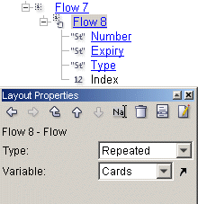

Repeated Flows Overview
Need to specify:
  Flow type
  Repeating array or variable
Flow icon changes
New system variable created
Notes:
When you enter a repeated data variable into your flow, you must follow that variable with a carriage return: otherwise, all contents will appear on the same line.
If you set a flow to be repeated by an array coming from the data there is a system variable Index created. The variable Index displays the index (begins from 0) of the current variable field coming from the array by which the flow is repeated.
If you use an object which uses variable which is logged to be out of context, e.g. a chart, image, etc., it is possible to place this object into a correct context by inserting it into a proper repeated flow (or repeated sub-flow inside repeated flow,…)

Slide 33
Repeated Flows – Tutorial
Modify the provided file and enhance it with repeated flow functionality.
Open Bank_3.wfd
On the Account page, create there a Flow area
Write inside there: “Debit cards bound to the account”
Insert a sub-flow to the actual flow
Inside this flow insert credit card information variables separated by tabulators
Proof the design (causes error)
Correct the error (the flow which includes the variables needs to be repeated by
Insert a heading above the variables (Number, Expiry, Type) and apply Offset Number paragraph style
Separate the heading titles by tabulators
Solution at Bank_3_Done.wfd
Notes:
For heading titles, make sure you have Offset Number paragraph style selected

Slide 34
6. Repeated Row Sets

Slide 35
Repeated Row Sets – Purpose
Used for building transactional documents
Different number of transactions per document
Need of listing several transactions from an array in one table
Similar usage as flow repetition but with possibility of enhanced formatting and headers/footers option
Notes:
Note that you are repeating the whole row (or cell flows inside) unless using another enhancement cell overflowing.

Slide 36
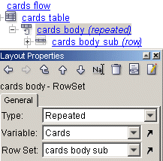
Repeated Row Sets Overview
A row set repeated by a selected array or integer variable
By default a Row Set is of a type Row or Row Set
If changed to Repeated, repetition array or variable needed
Repeated row set has a new sub-row set created
Notes:
Now when you insert variables from Cards array into this RowSet 2 (sub row set of the repeated RowSet 1)
Of course in each repeated Row Set you can but any object which is reported to be out of context, e.g. a chart, image, flow, etc.

Slide 37
Repeated Row Sets – Tutorial
Modify the provided file and enhance it with repeated row set functionality.
Open Bank_4.wfd
On Account page create a flow area and inside it a table
This table has just one header row, one body row and 3 columns
Header row is set to empty
Write into each column of the first row Number, Expiry, Type
Fill the second row (body) with Number, Expiry, Type variables
Proof the solution (causes error)
Fix the problem and proof again
Now you see that the flow area with repeated flow displays the same information as the flow area with the table using different functionality
Delete the flow area with the repeated flow
Solution at Bank_4_Done.wfd
Notes:
Note: Place a flow area on the page containing “Credit Cards Bound to the account”
Problem is fixed by specifying body row set to be repeated by cards array

Slide 38
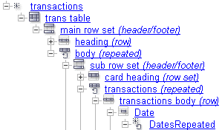
Repeated Row Sets Complex Solution
It is possible to define complex tables
Repeated row set
Sub-row set is of a type header/footer
Any of its sub-rows (headers, body or footers can be repeated as well
Repeated Cell Flow
Etc.

Slide 39
Repeated Row Sets – Tutorial
Modify the provided file and enhance it with repeated row set functionality.
Open Bank_5.wfd
On the account page create a new flow area with a table inside it
The table has one repeated body by Cards
Change sub-row set of the repeated body to be header/footer
First Header has two rows (first displays the card number, second the names of all variables from Transactions)
Header has one row which is identical as the second row from First Header
Body is repeated by Transactions and contains all its variables
Table is overflowing to the next page (Next Page tab of Account page
Solution at Bank_5_Done.wfd
Notes:
Problem is fixed by specifying body row set to be repeated by cards array
Overflowing is to the same page (Account)

Slide 40
7. System Variables

Slide 41
Paging Variables
Some system variables are closely bound to repeated functionality:
Page counter – (Data | Records by)
PagesPerRecord – (Data | Records by)
PagesPerSubRecord – (Pages | Repeat by)
PageSubCounter – (Pages | Repeat by)
PageArrayIndex – (Pages | Repeat by)
Check in help: System Variables | How to Use System Variables
Notes:
Page counter - Variable returns current layout page number within current record defined in Data node (Records by:). I.e., the number of the page for the data record currently being printed.) It starts from 1 again on next record
PagesPerRecord - The number of pages that will be built for a record.
PagesPerSubRecord - The number of pages that will be built for a sub-record
PageSubCounter - The current layout page number. (I.e., the number of the page for the sub-record currently being printed.)
PageArrayIndex - Starts at 0 and keeps tracking which sub-record you are on.
Look at the help and search for the topic mentioned on the slide. Look at the picture displayed. This picture thoroughly describes the logic and functionality of all the variables.

Slide 42
Repeated Row Sets – Tutorial
Add paging variables to each job. Test the paging functionality.
Open Bank_6.wfd
Place on every page Page Counter and PagesPerRecord variable
Check whether the paging work
Open Bank_6_Done.wfd
Open Bank_7.wfd
Create a new flow area and insert in it:
  PageCounter and PagesPerRecord
  PageSubCounter and PagesPerSubRecord
Place this flow area on both pages
View the result
Solution at Bank_7_Done.wfd
Notes:
Since pages are repeated by account, every account has its own paging (pages per sub-record, sub-record counter)
For the whole record (Data | Records by) there is paging as well (page counter, pages per record)

Slide 43
8. Possible Problems and Issues
Notes:
Note for trainer: This chapter is optional in case of interest or sufficient time

Slide 44
Variable Fill Style
Variable fill style controlled by a variable not it proper context
Limitation:
Context for fill style can be set by (Data | Records by, Pages | Repeated by, and Page | Repeated by)
Workaround:
Use Flow Selected by or Row Set Selected by (most common, without using variable fill style)
Use the text with proper text style using variable fill style in element
Element is placed into the repeated table or flow
Check Fill.wfd.
Notes:
Fill styles: Evaluated in a page context, not in flow area context (repeated flow or row set will not work)
The most common way how to color something variably is to have flow or row set selected by int, condition, etc. in order to ensure the correct context
Check Fill.wfd file. Check all the contexts (Data, Pages, Page) – three levels. Since the fill style is controlled by a variable bound to context of Tr array, simple applying variable fill style on variables will not work (because fill style can be only in context of page). The work around is to create an element with flow area with a variable colored by the variable fill style. The element is inserted into body row and fill style works properly.
Limitation of workaround: Cannot set variable size of element object. When changing global variables in element, in will not be affected. The result is dumped.

Slide 45
Global Variables Updating
Global variable is updated in:
A table row:
  Updating works correctly within the table
Limitation:
An element in a table from previous slide
  Updating does not work (the result is dumped)
Workaround:
None
Check Globals.wfd.
Notes:
The result is dumped because PrintNet T draws these elements at the end.

Slide 46
Page | Repeat by vs. Overflowing
When there is a sequence of pages:
Page 1 – overflowing from
Page 2 – repeated by a variable or array
Page 3 – overflowing to (itself)
Limitation:
Page 3 – values start from the beginning even though they overflow from Page 1
No warning reported that content of flow on Page 1 to big to fit
Workaround:
Reorder sheets by impositioning
Check Repeat.wfd.
Notes:
Note: Every repetition of page restarts flows overflowing, therefore in this case overflowing does not work correctly.

Slide 47

Data Context – Summary
In this presentation we talked about:
Data context managed by:
  Data | Records by
  Pages | Repeated by
  Page | Repeated by
  Repeated Flow
  Repeated Row Set
Possible limitations and workarounds

Slide 48

Data Context – Discussion
Answer the following questions:
How to split each client (record) into separate unique file?
What is the difference between Pages | Repeated by and Data | Records by?
What is Group Begin, where to view it and how to change it?
In which cases would you use:
  Repeated flow
  Repeated Row Set?
Notes:
In production select the file name, e.g. insert there %g to make it variable enough and check the checkbox Split by group
For Records by, you count with splitting clients into separate files, envelopes, etc., but Repeated by pages repeat the design according to some array when you do not need or do not want to create multiple records.
Beginning of group (Data | Records by), usually the first page of client. Can be seen in proof and can be changed by Sheet Regrouper.
Flow – no need of special formatting or headers/footers, Row Set – need of using headers/footers.

Slide 49

Thank You.
Do You Have Any Questions?

